Slide 1
Emotion Recognition Project
Pattern Recognition
Karam Alhanatleh
0201517

Slide 2
Introduction
The project addresses the need for more effective human-computer com
A shift from text-based to visual communication for a more sophisticated approach.

Slide 3
Objective
Improve visual communication and understand human emotions.
Enhance interaction between humans and devices using advanced deep learning techniques.

Slide 4
Model Architecture
Emotion recognition model built as a Convolutional Neural Network (CNN).
Key Components:
Convolutional Layers for feature extraction.
Max Pooling Layers for down-sampling.
Batch Normalization for stabilizing and accelerating training.
Dense (Fully Connected) Layers for classification.
Dropout Layers for regularization to prevent overfitting.

Slide 5
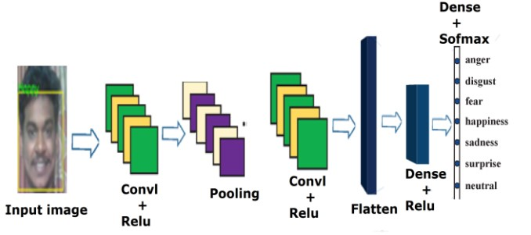
Model Architecture
Image From by Human Emotion Recognition System Using Deep Learning Technique
Notes:
https://www.pnrjournal.com/index.php/home/article/download/2967/2828/3733#:~:text=Emotion%20recognition%20is%20an%20important,fearful%2C%20surprised%2C%20and%20neutral.

Slide 6
Training Process
Training setup with Adam optimizer, categorical crossentropy loss.
Batch size of 32, validation split of 20%.
Dynamic adjustment of learning rate with ReduceLROnPlateau callback.
Early stopping mechanism to prevent overfitting.

Slide 7
Dataset
Data collected from Kaggle, 35,887 facial images annotated with emotions.
Preprocessing: Standardizing image dimensions, converting to grayscale, normalizing pixel values.
Data augmentation techniques for model generalization.

Slide 8
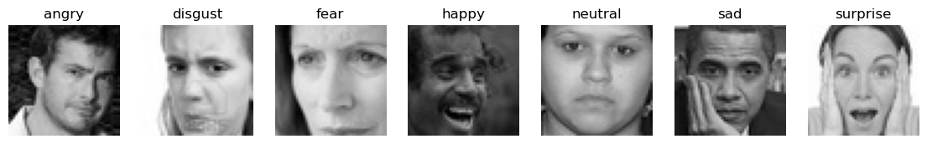
Emotion classification
Anger Disgust Fear Happy Neutral Sad Surprise.
Sample data image from code

Slide 9
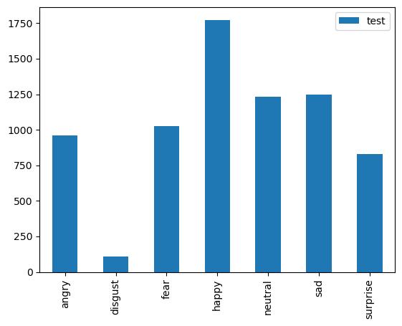
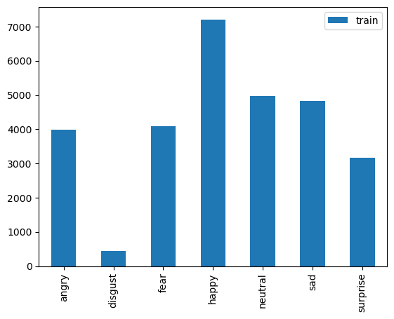
Data distribution
Data distribution classification dataset
From code

Slide 10
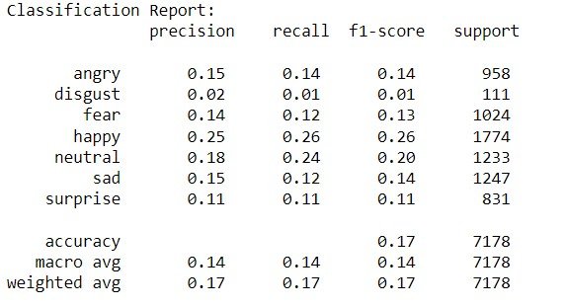
Model Evaluation
Classification report

Slide 11
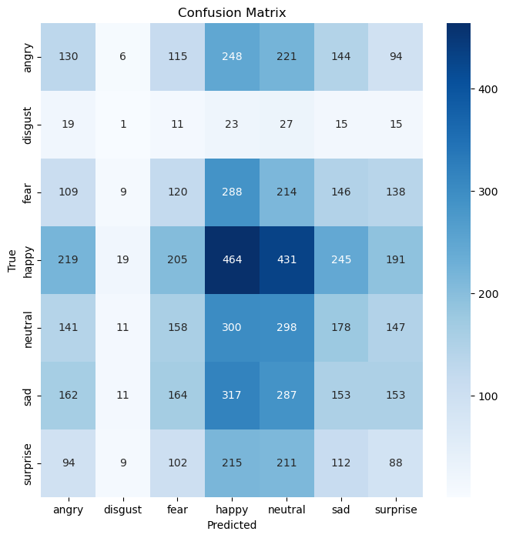
Model Evaluation
Confusion matrix

Slide 12
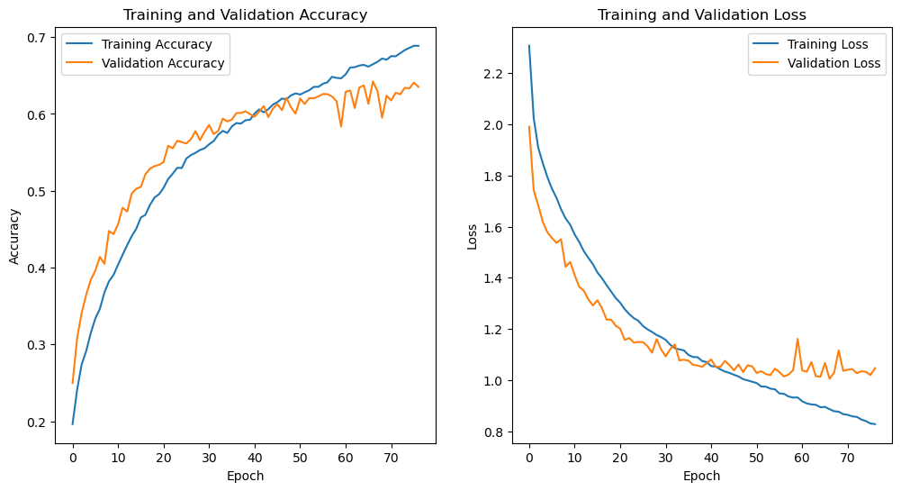
Model Evaluation
Training and validation accuracy Loss

Slide 13
Real-Time Emotion Recognition
Live Facial Analysis: The code captures frames from a camera stream, identifies faces, and analyzes them for emotional expressions.
Model Integration: Utilizing the pre-trained emotion recognition model, the system predicts emotions based on detected facial features.
Interactive Visualization: The predicted emotions are visually displayed on the video stream in real-time, providing an interactive and engaging user experience.

Slide 14
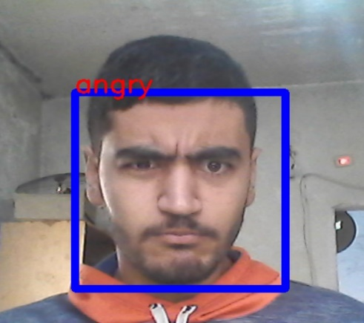
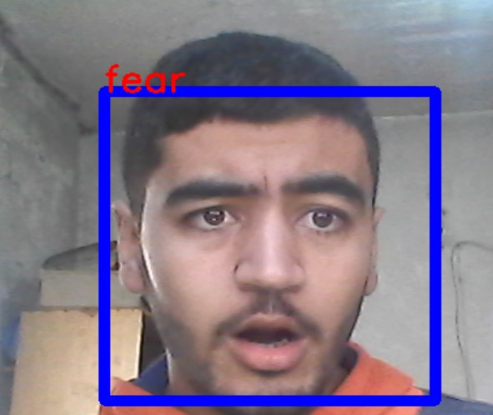
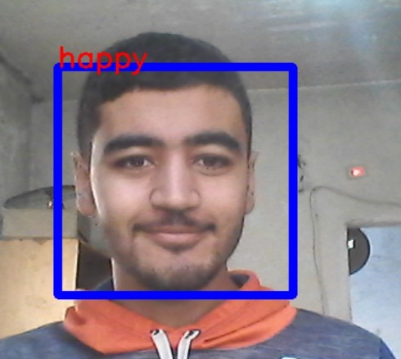
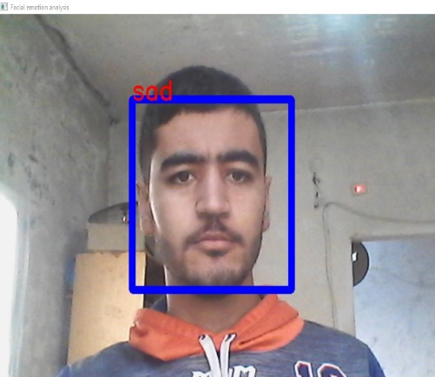
Real-Time Emotion Recognition
Many example

Slide 15
Challenges and Limitations
My resources are limited
Image quality bad

Slide 16
Applications and Future Work
Healthcare:it can be used in mental health assessments or patient monitoring to detect signs of distress or discomfort.
Education:By analyzing students' facial expressions educators can gain insights into their emotional states
Business : From customer service interactions to employee engagement,

Slide 17
Conclusion
Exploration of real-world applications and integration into interactive systems.
The project marks a pivotal turning point in human-computer communication, unlocking unprecedented possibilities for more precise and responsive interactions.
Continuous model refinement based on user feedback and evolving deep learning methodologies.

Slide 18
Any Questions

